Slide 1
7. Telecom testing
Sample test cases - Telecom Billing System
Verify, the telephone number of the customer is registered under telecom operator
Verify whether the number is still working
Verify the number entered is valid, and it is 10 digit number
Verify the number is not blocked due to some reasons
Verify if the number has any outstanding bills, if exist, display it on screen
Verify the number has all previous accounts or bills cleared
Verify the system enables statement generation as per customer requirement
Verify the system has recorded a number of calls accurately
Verify the plan chosen by the customer displays on the billing system
Verify the total amount billed is accurate and mapped to the service offered

Slide 2

8. Social Impact
https://spark.adobe.com/video/SouueHjvnqBmk

Slide 3


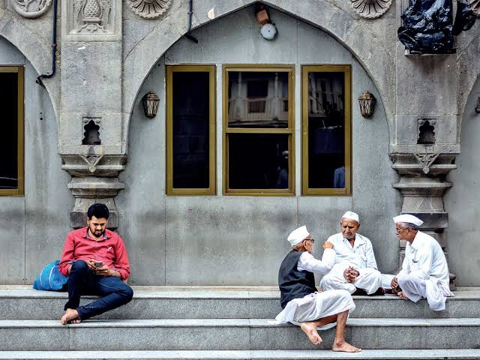
8. Social Impact
Negative Impact

